Slide 1
Patient's Condition Classification Using Drug Reviews
Project Group - 1

Slide 2
Business objective
To predict the patient’s condition—such as Depression, Type 2 Diabetes or High Blood Pressure—from patient reviews using NLP
To recommend alternate drug in case of patient dissatisfaction

Slide 3
Pre processing steps
Text cleaning was performed using NLTK
Lemmatization to reduce words to the base form
Challenge:
Encountered 899 null values during data cleaning
Messy User Reviews: Reviews had spelling mistakes, slang, and random text
Resolution:
Filtered the dataset to include only the target conditions: Depression, Diabetes Type 2 and High Blood Pressure. This effectively removed all null values from the working dataset
Cleaned the text using basic NLP tools to make it easier for the model to understand

Slide 4
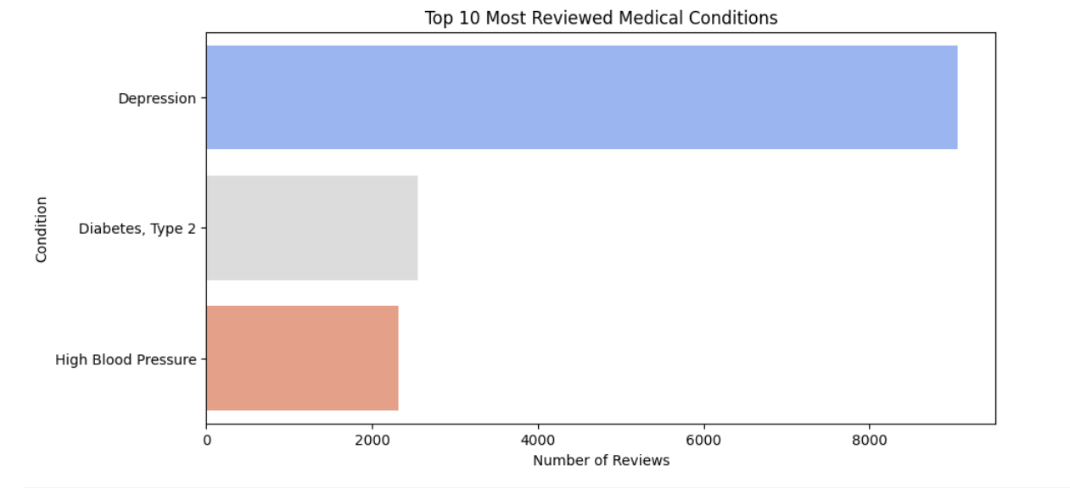
EDA Insights and Data Visualization
Univariate analysis was performed – Depression was the most reviewed medical condition followed by Diabetes Type-2 and High Blood Pressure

Slide 5
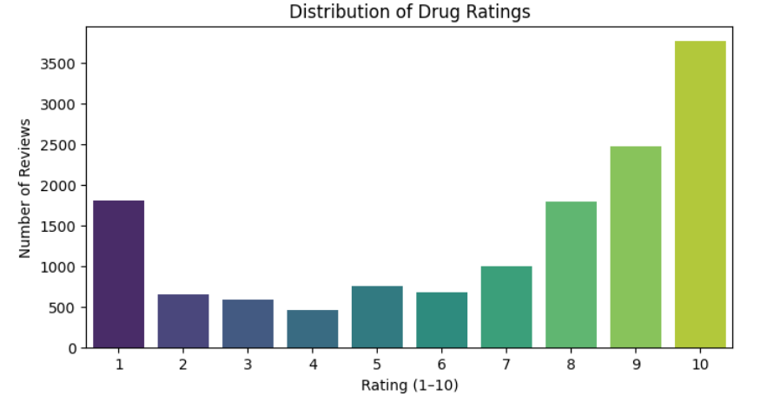
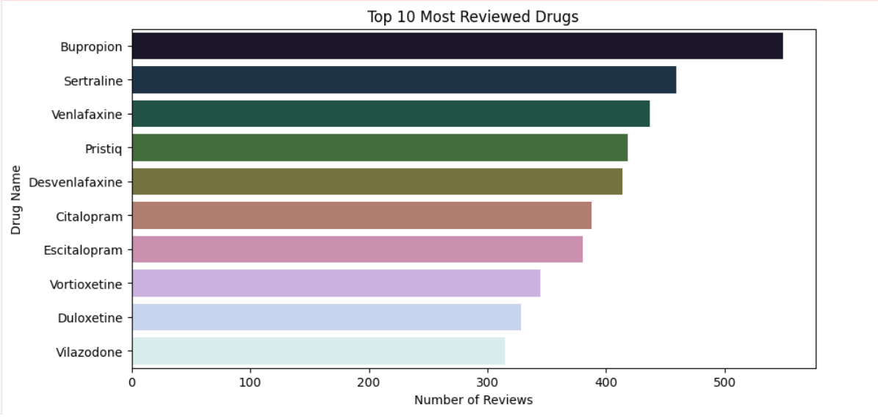
Distribution of drug ratings- Highest rating was 10 with about 3700 ratings in this category. The lowest was 4 with around 450 ratings in this category
Most reviewed drugs – Bupropion followed by Sertraline and Venlafaxine

Slide 6
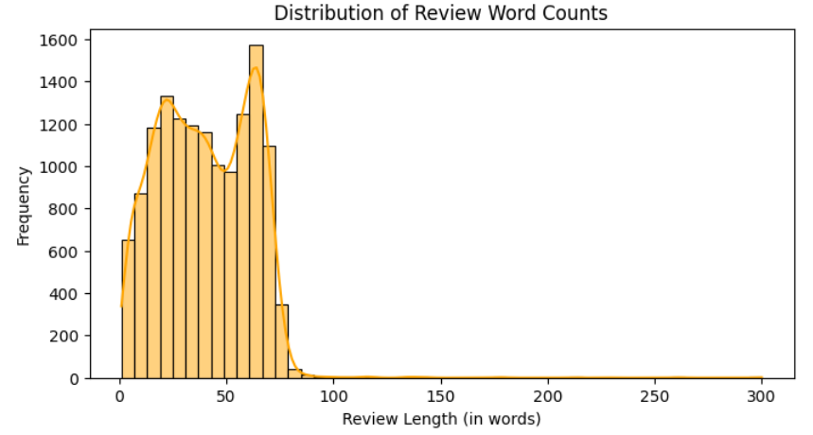
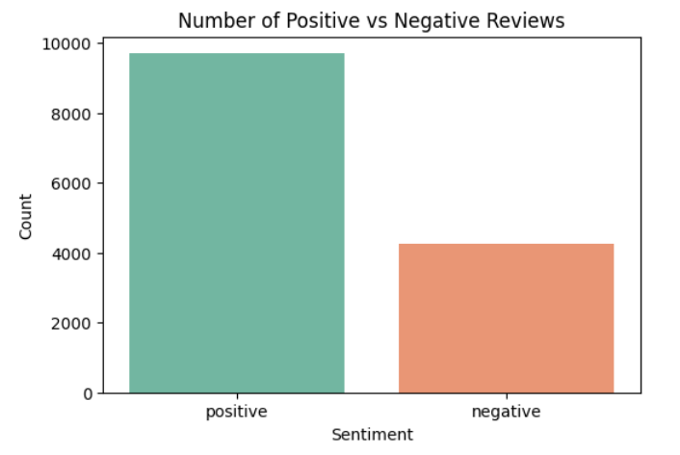
Distribution of review word counts
Most reviews are between 20–80 words
The distribution peaks around
60 words
The highest frequency is just
over 1500 reviews for this word count range
A few reviews are very long (over 100–300 words)
Most reviews are much shorter, concentrated below 80 words
Sentiment Distribution
Positive reviews are significantly higher. There are approximately 9,700 positive reviews
Only about 4,300 negative reviews

Slide 7
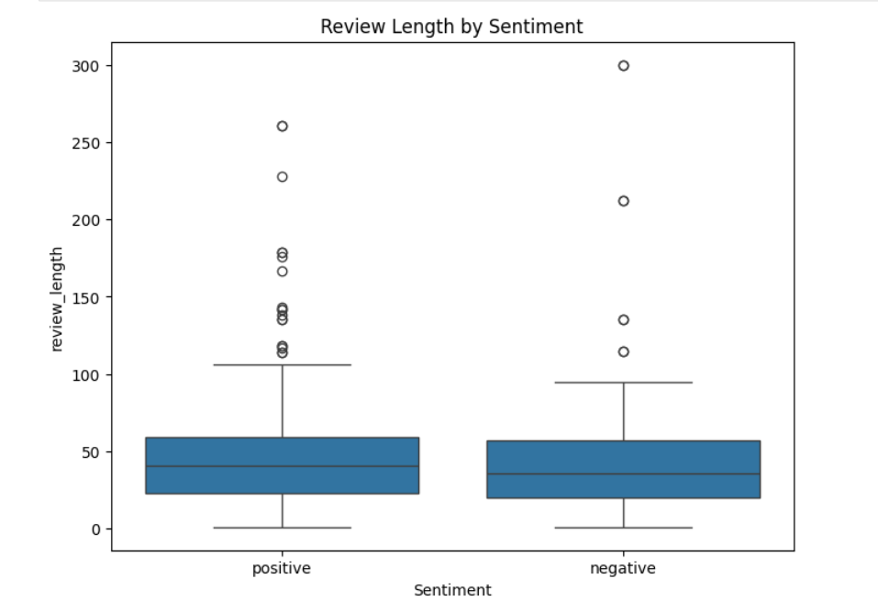
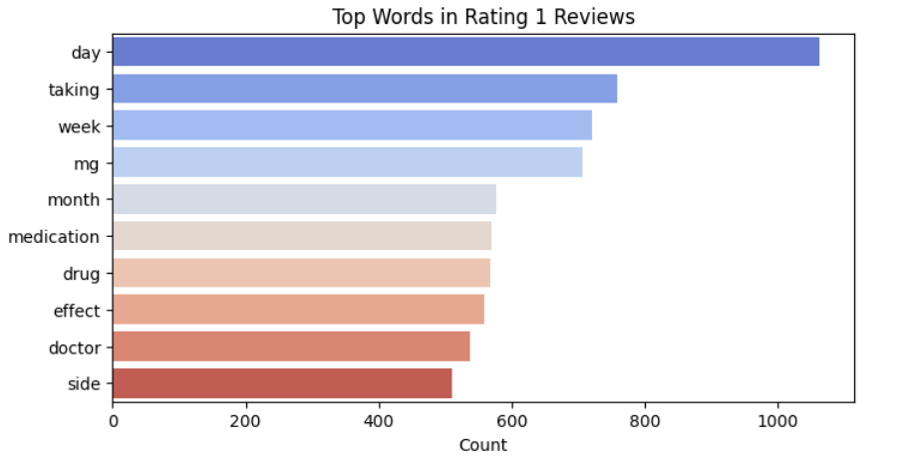
Bivariate Analysis
Review Length by Sentiment:
Review Length Is Similar Across Sentiments
Both positive and negative reviews have a similar median length (around 35–40 words)
The interquartile ranges (IQR) are nearly the same: most reviews fall between ~20 and ~65 words
Both positive and negative reviews have outliers (some very long reviews), with:
One negative review nearing 300 words
Several positive reviews between 150–250 words
Word frequency by rating was analysed and plotted
Top word for rating 1, 2, 3, 4, & 5 were – “day”, “week”, ”mg” and “taking”

Slide 8
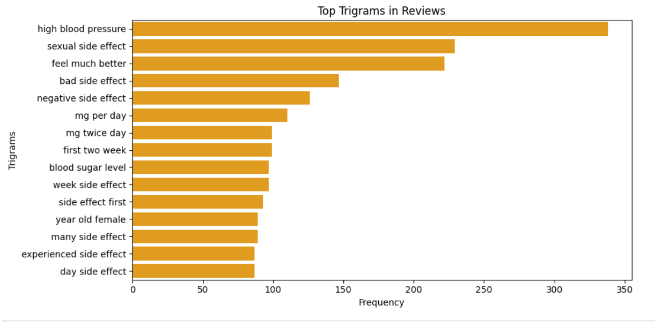
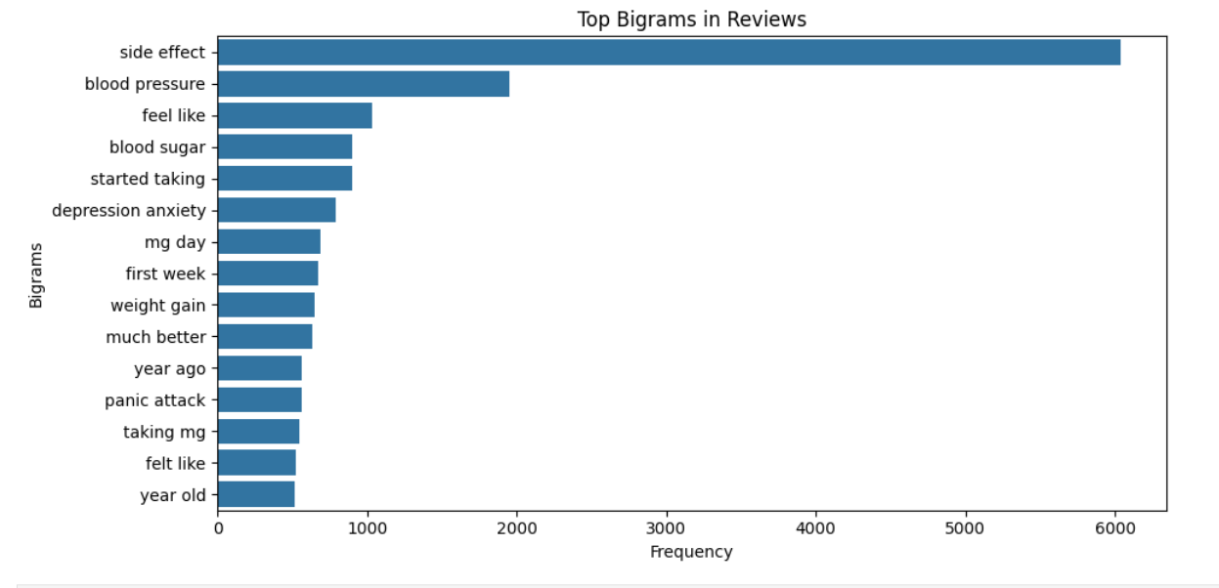
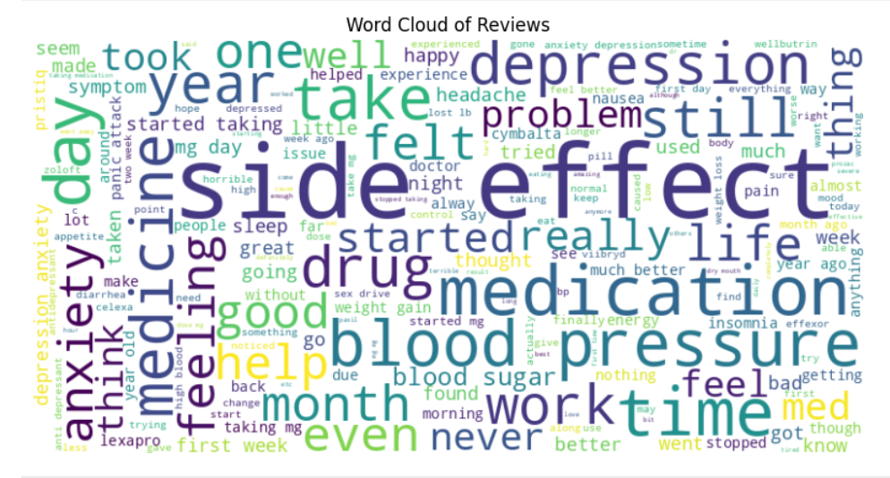
N-gram analysis and Word cloud
Tri-gram
Bi-gram
Word cloud

Slide 9
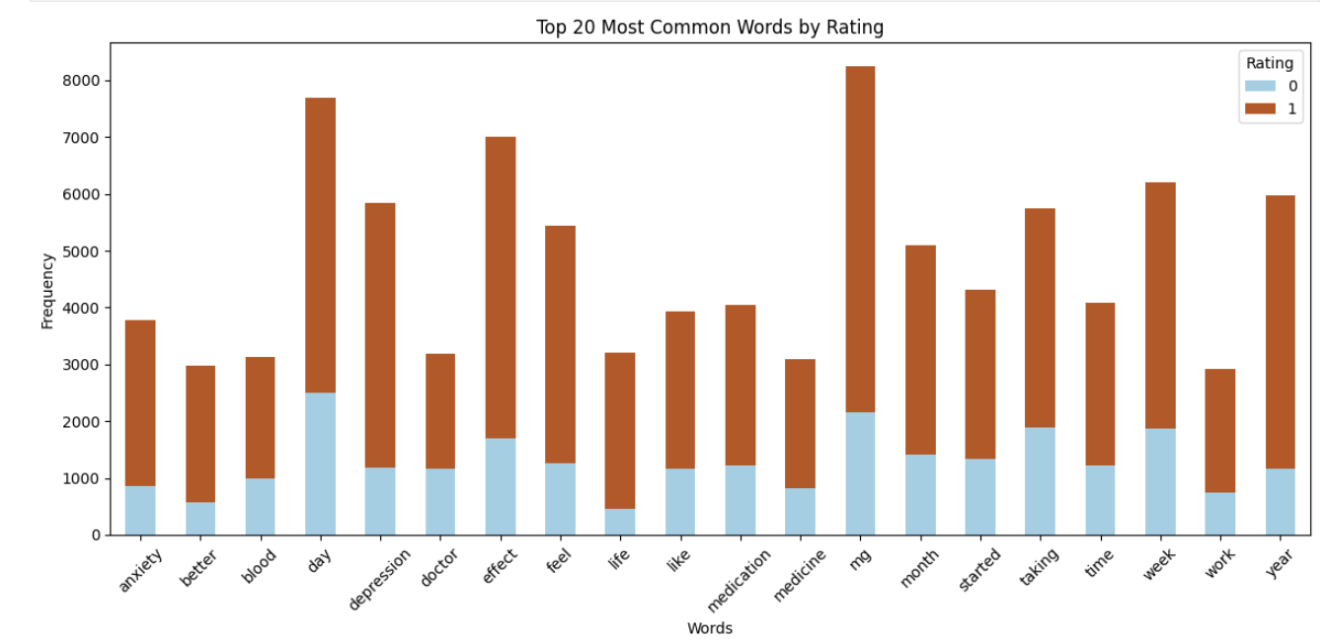
Count vectorizer:
Words Like “day”, “week”, “mg” and “effect” occur more in positive reviews
This suggest patients often talk about dosage, duration and progress, possibly indicating effective treatment experiences
Balanced Words Used Across Both Sentiments
- Words like “doctor”, “blood”, “medication”, and “like” show relatively balanced usage across both ratings
These are more neutral or factual terms, commonly used regardless of sentiment
Some Negative Sentiment Association
Words like “depression” and “anxiety” are prominent, even in negative ratings (large light blue portions), which may signal:
Reviews from patients not seeing improvement in those conditions

Slide 10
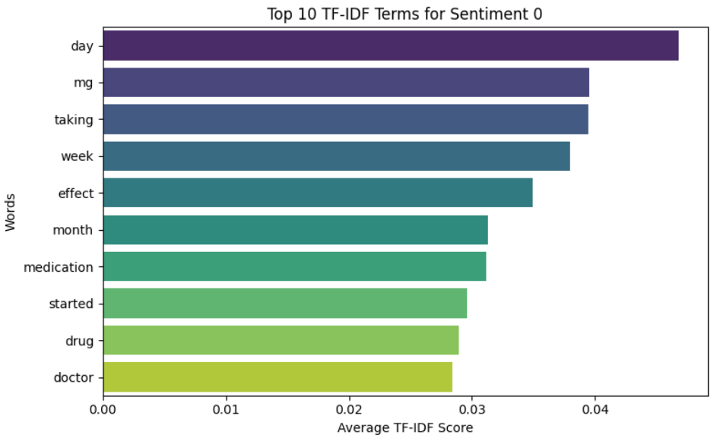
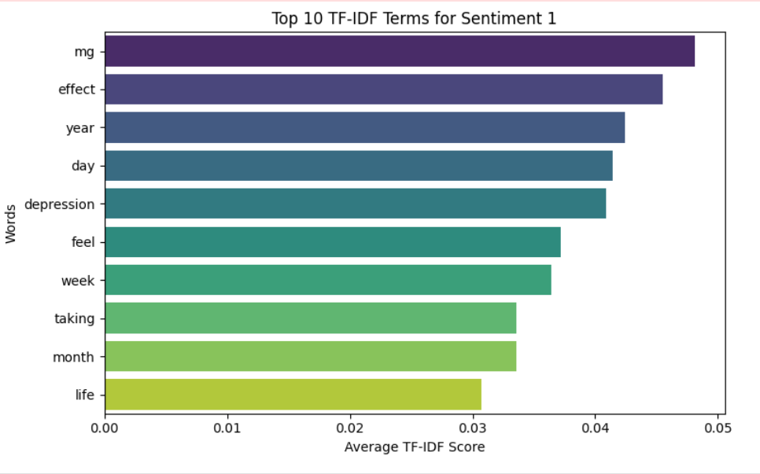
TF-IDF Analysis
Sentiment 0 - Negative sentiment
Sentiment 1 - Positive sentiment

Slide 11
Sentiment 0 :
These insights help us understand which words are more influential (i.e., uniquely important) in each sentiment class. These reviews often revolve around timing, dosage, and disappointment in efficacy
Sentiment 1:
These reviews focus on successful treatment, symptom relief, and emotional improvement
Rank | Word | Insight
1 | Day | Likely refers to how long the user tried the drug without benefit
2 | Mg | Highlights dosage concerns, possibly due to ineffectiveness or side effects
3 | Taking | Frequently used when users discuss ongoing treatment with no relief
Rank | Word | Insight
1 | mg | Likely reflects dosage, but likely used in successful treatment stories
2 | effect | Likely highlights positive outcomes of the drug
3 | year | Indicates long-term benefits — users report improvement over time

Slide 12
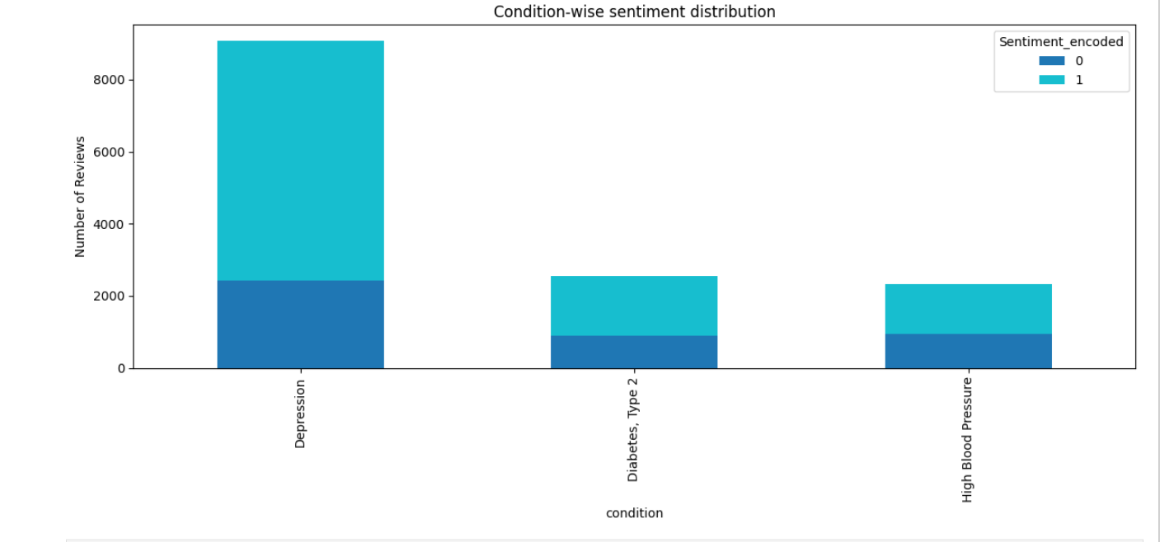
Condition wise sentiment distribution
Depression
Has the highest number of reviews overall, significantly more than the other two conditions
Majority of the reviews are positive, but a considerable portion (~25%) are negative
This suggests:
High patient engagement with antidepressants (more feedback)
Patients report positive sentiment, though a meaningful group may experience adverse effects or no improvement
Diabetes, Type 2
Fewer total reviews compared to depression
Positive reviews are roughly double the negative ones
Indicates:
Moderate patient satisfaction with diabetes medications
Likely variability in drug effectiveness, with some unmet expectations
High Blood Pressure
Similar trend to diabetes: more positive than negative reviews, but total volume is slightly less
Possibly due to:
Effective blood pressure control with available medications
Fewer side effects or better tolerance in the user base

Slide 13
Model building

Slide 14
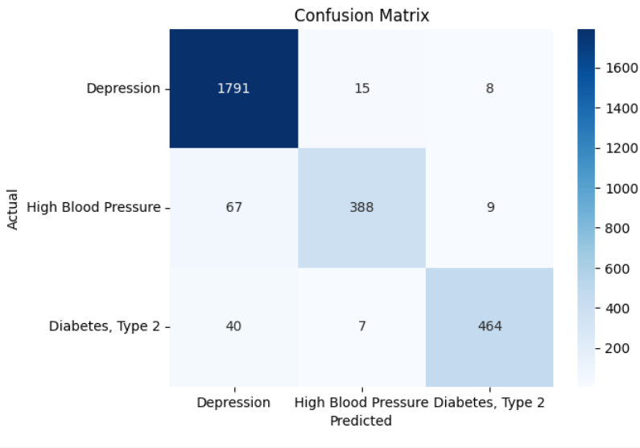
Logistic Regression
Accuracy – 94.76%
High Accuracy for Depression:
The model correctly predicted 1791 out of all Depression cases
Very few were misclassified as High BP (15) or Diabetes (8)
This class shows the strongest performance
Moderate Accuracy for High Blood Pressure:
388 correctly predicted
However, 67 instances were misclassified as Depression — a notable misclassification
Minor confusion with Diabetes (9 cases)
Diabetes, Type 2 – Reasonably Accurate:
464 correct predictions
Some confusion with Depression (40) and High BP (7), but not as severe

Slide 15
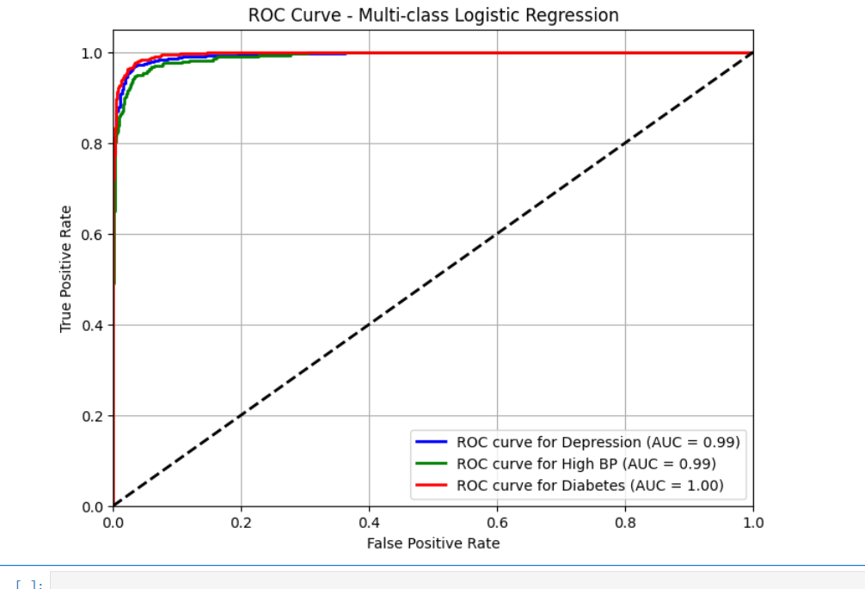
The AUC values close to 1 suggest that the model can be trusted to make reliable predictions for Depression, High BP, and especially Diabetes. However, such high AUCs has a probability of overfitting.

Slide 16
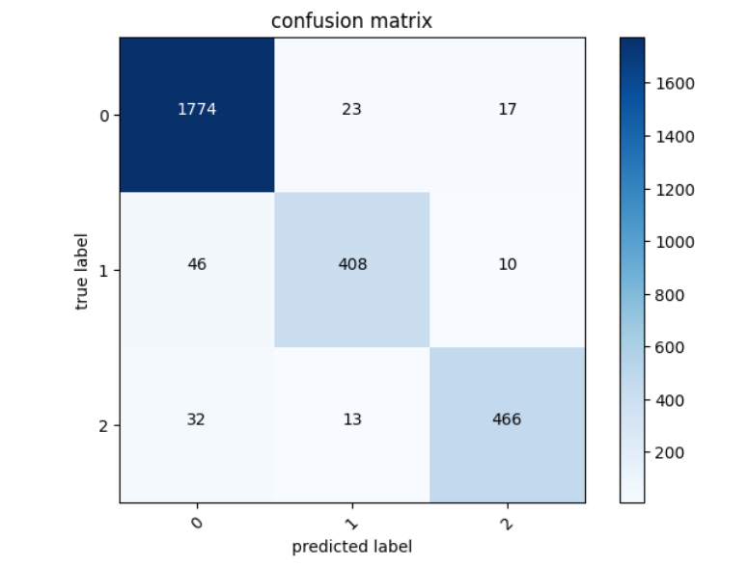
Naive Bayes
Accuracy – 94%
High Accuracy for Class 0 (Depression):
- The model correctly predicted 1774 out of all true Class 0 cases
- Only 23 were misclassified as Class 1 (High BP) and 17 as Class 2 (Diabetes)
- This class shows the strongest performance, with minimal confusion
Moderate Accuracy for Class 1 (High Blood Pressure):
- 408 instances were correctly predicted
- However, 46 were misclassified as Class 0 (Depression), indicating some overlap or feature similarity
- 10 were misclassified as Class 2 (Diabetes), though to a lesser extent
Overall, performance is solid, but with notable confusion with Class 0
Good Accuracy for Class 2 (Diabetes):
- 466 predictions were correct
- 32 were misclassified as Class 0 (Depression) and 13 as Class 1 (High BP)
- While there is some confusion, performance remains strong and consistent

Slide 17
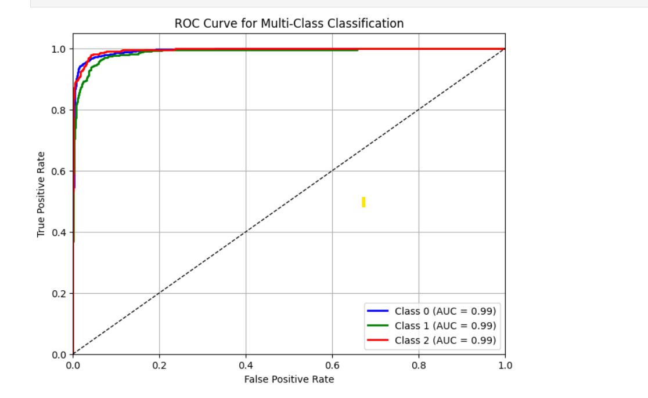
This model is very strong across all classes, with minimal drop-off in performance for any individual class.
However, it's worth monitoring that despite equal AUC values, misclassification patterns
(seen in the confusion matrix) still exist — especially between Class 1 and Class 0.

Slide 18
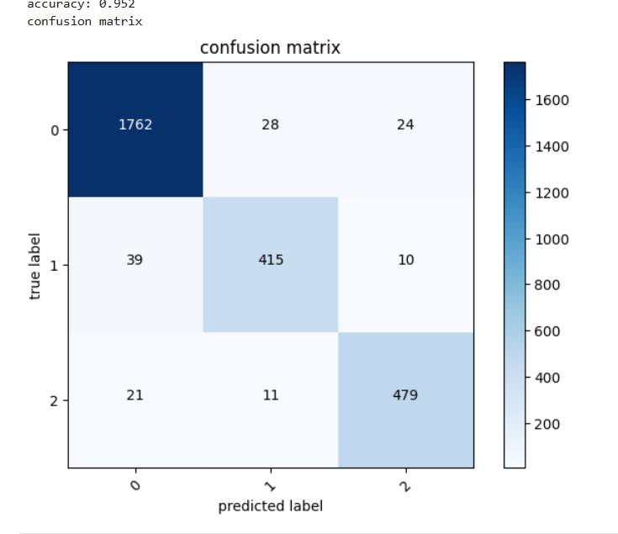
Passive aggressive classifier
Accuracy – 95%
High Accuracy for Class 0 (Depression):
- The model correctly predicted 1762 instances
- Only 28 were misclassified as Class 1 (High BP) and 24 as Class 2 (Diabetes)
- This class shows exceptionally high performance, with over 96% accuracy and minimal confusion
Strong Performance for Class 1 (High Blood Pressure):
- 415 cases were correctly classified
- 39 instances were misclassified as Class 0, and 10 as Class 2
- While the class is predicted well, there’s some confusion with Class 0, likely due to overlapping features
Reliable Accuracy for Class 2 (Diabetes):
- 479 correct predictions
- Minor misclassifications: 21 as Class 0 and 11 as Class 1
- Shows improvement over the previous matrix — more confident predictions and reduced error

Slide 19
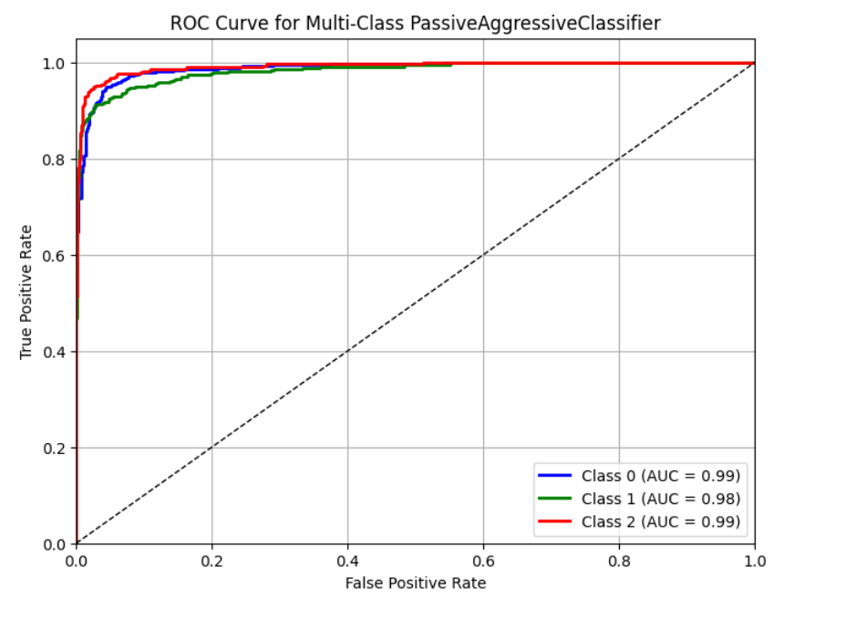
The Passive Aggressive Classifier performs exceptionally well in this multi-class setting
While Class 1 (likely High BP) shows slightly lower AUC, it's still well above typical performance thresholds
Combined with confusion matrix insights, this model offers strong generalization and high
discriminative power across all classes

Slide 20
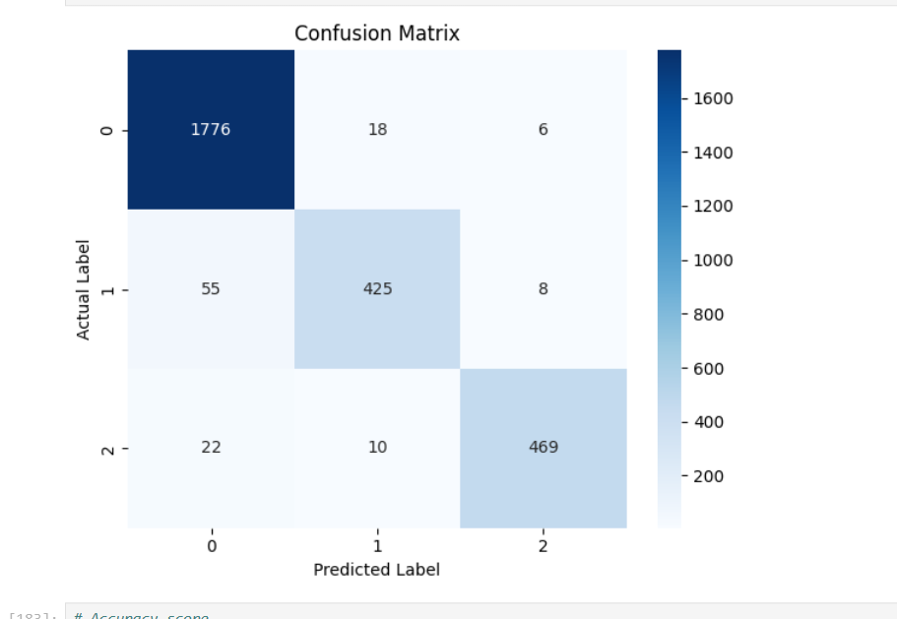
Support Vector Machine
Accuracy – 95.73%
Depression, Class 0 – Extremely High Accuracy:
- This is the best-performing class with very minimal confusion
- Indicates strong feature separability for this class (likely Depression, based on earlier context)
High Blood Pressure, Class 1 – Good Accuracy, Some Confusion:
- The model confuses Class 1 with Class 0 more often than vice versa
- Suggests that Class 1 shares feature similarity with Class 0, possibly making boundary decisions harder
Diabetes, Class 2 – High Accuracy, Slight Overlap:
- Still performs very well, though minor confusion exists
- Class 2 remains consistently strong across all previous matrices and ROC curves

Slide 21
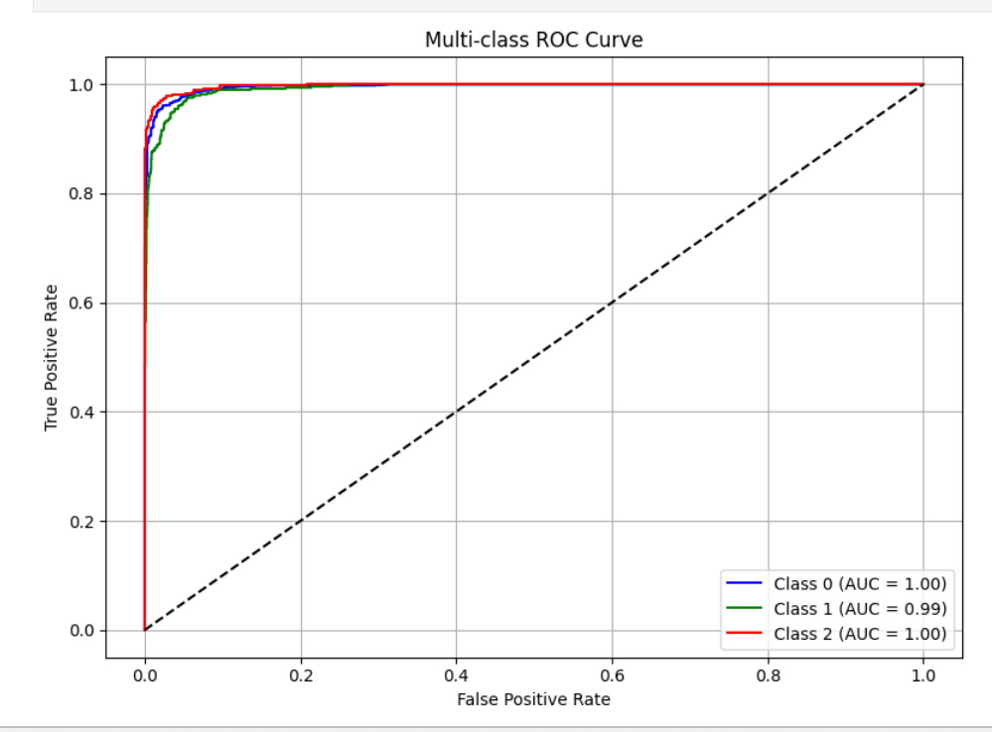
This is a top-tier model performance, particularly for a multi-class classification task
Any misclassifications are likely due to minor overlap in features rather than major model weakness

Slide 22
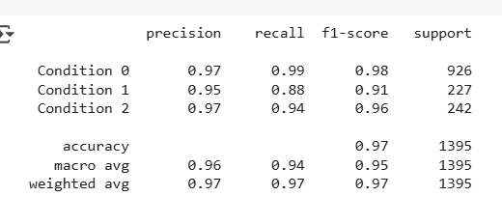
BERT
Accuracy – 96.55%
Condition 0 (Depression)
Insight: This class shows the strongest performance, with both high precision and recall. The model almost never misses a Condition 0 case.
Condition 1 (High Blood Pressure)
Insight: The model struggles a bit more with identifying Condition 1. A significant number of true cases were missed (false negatives). Needs improvement in recall.
Condition 2 (Diabetes)
Insight: This class is handled quite well by the model, with a high F1-score and minimal misclassification.
Key insights
The model performs exceptionally well overall
Condition 1 is slightly underperforming compared to the other two — focus on improving recall for this class
Balanced precision and recall suggest that the model is not just memorizing, but generalizing well across classes

Slide 23
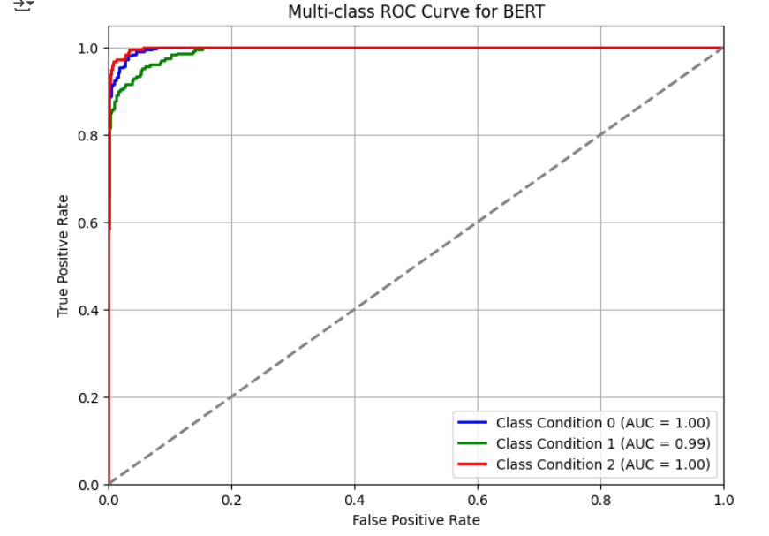
BERT performs at or near perfection in multi-class classification for the dataset
Both Class 0 and Class 2 are flawlessly handled
Class 1, while still highly accurate, shows slight room for improvement
Top performance model

Slide 24
Challenges faced for creating BERT model-
Long Training Time & Crashes
Initial training of the BERT model on local machines or Jupyter Notebook took over 14 hours, frequently crashing due to resource exhaustion
The training speed was very slow due to small batch sizes and default settings
TensorFlow Compatibility Issues
The TensorFlow version used was incompatible with installed versions of NumPy and other dependencies. This led to import errors
Resource Constraints
Memory limitations in the local environment made it difficult to fine-tune BERT
Frequent kernel restarts during model training hindered experimentation

Slide 25
Resolution-
Switched to Google Colab
Migrated the project to Google Colab, which offered free GPU access, more memory, and greater stability
This move reduced crashes and allowed longer training sessions
Optimized Hyperparameters
Batch size (per_device_train_batch_size) was increased from 15 to 50, which improved training speed and memory efficiency
Epochs were reduced from 3 to 1 to prevent overfitting and reduce time per run
Transitioned to PyTorch
Switched from TensorFlow to PyTorch, which had better compatibility with the current environment
PyTorch’s seamless integration with Hugging Face Transformers made implementation more manageable
Model-Specific Fixes
Adjusted the tokenizer usage to avoid TensorFlow dependency (return_tensors='pt' used for PyTorch)
Thus, overall time to train the model was thereby reduced to about 4 hours

Slide 26
Deployment

Slide 27
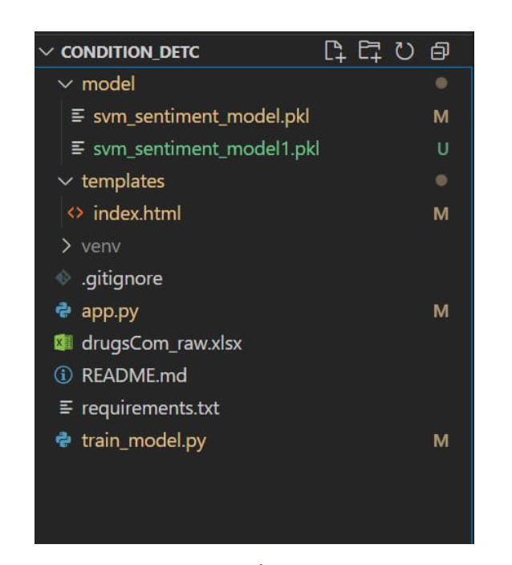
Tools & Technologies Used
Editor Used: VS Code
Deployment: Flask Web Application
File structure

Slide 28
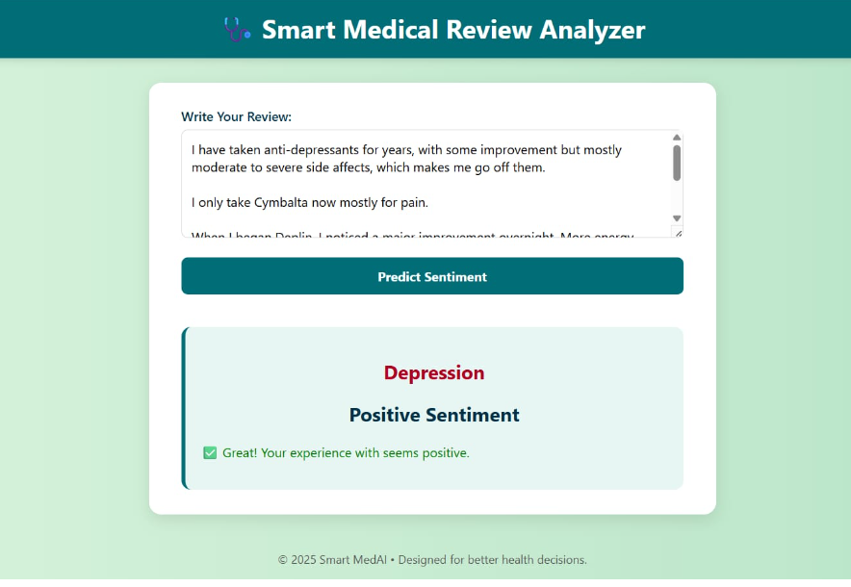
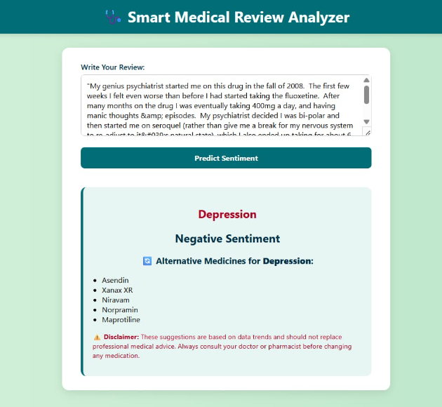
Input – Patient review
Output – Predicts disease condition and sentiment
For Negative sentiment- Alternate drugs would be recommended

Slide 29
Challenge: Predicting Two Things at Once: Needed to predict both condition and sentiment from one review
Resolution: Built two separate models – one for condition and one for sentiment – and combined their results
Challenge: Suggesting Alternative Drugs. When a review was negative, we had to find better drug options
Resolution: Created a list of alternative drugs for each condition and showed them when needed
Challenge: Connecting Model with Flask App. Hard to run machine learning inside a web app smoothly
Resolution: Loaded the model once when the app started and used it for fast predictions

Slide 30
Conclusion- Model Comparison & Key Insights
Overall Accuracy:
Logistic Regression: 94.76%
Naive Bayes: 94.0%
Passive Aggressive Classifier: 95.0%
SVM: 95.73%
BERT: 96.55% (Best Performing)
Best Performing Class: Across all models, Depression (Class 0) consistently shows high prediction accuracy, minimal confusion, and strong feature separation
Challenging Class: High Blood Pressure (Class 1) often gets confused with Depression — possibly due to overlapping language or shared symptoms in reviews. This class had lower recall in most models, especially in BERT, indicating room for improvement
Strong Consistency: Diabetes (Class 2) maintained stable accuracy across all models, with minimal misclassification and high precision
Why BERT Excels:
Achieved the highest accuracy (96.55%)
Shows balanced precision and recall, indicating robust generalization
Particularly strong for Depression and Diabetes
However, SVM was chosen for model building due to its faster training time and lower computational requirements

Slide 31
Thank you

